Slide 1
IMAGE CAPTIONING APP
App User Manual
Author: Kevin Johnson George

Slide 2
TABLE OF CONTENTS
Acknowledgements
01
About Me
02
About My Internship Journey With Clevered
03
Instructions on Using the App
Contact Information
About App
04
05
06

Slide 3
ACKNOWLEDGEMENTS
I would like to express my sincere gratitude to my mentors, Mr. Ken for the continous support I have received during my journey in App Development and for their motivation, guidance and advices that helped me through.

Slide 4
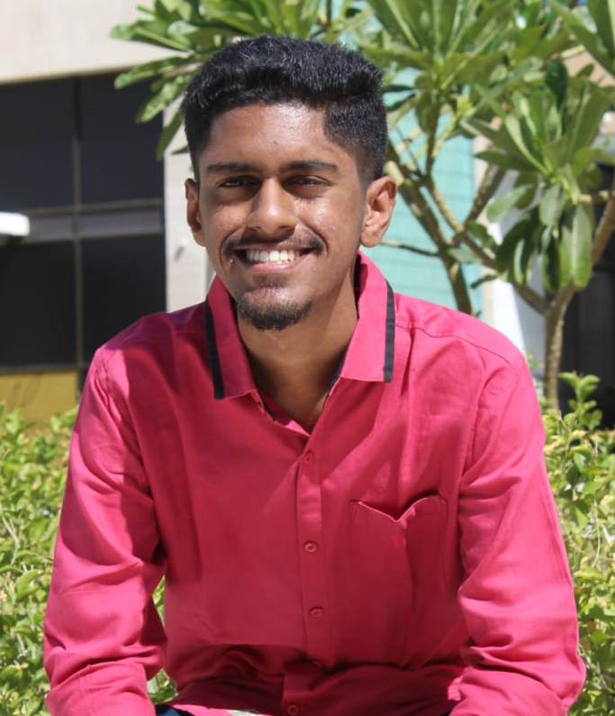
ABOUT ME
Introduction
Name: Kevin Johnson George
Age: 19
Education: Bachelor’s Degree in Computer Science
Interests
AI is already everywhere. AI & Machine Learning benefits in the society and can improve user experience with the help of virtual assistants, chatbots and more in apps.

Slide 5
ABOUT MY INTERNSHIP JOURNEY WITH CLEVERED
During my internship experience, I have developed my knowledge and skills in different areas of Machine Learning.
Thanks to this internship, I was able to do various tasks and innovate them.
It’s been an enjoyable journey overall learning various topics.

Slide 6
ABOUT APP
Image Captioning App
ABOUT PROJECT
MOTIVE
BENEFITS
Image Captioning
Identifies images and generates textual description
Display captions on image
General interest
Help people with disabilities
Helps users efficiently
Aids visually impaired
Can classify images
Face recognition

Slide 7
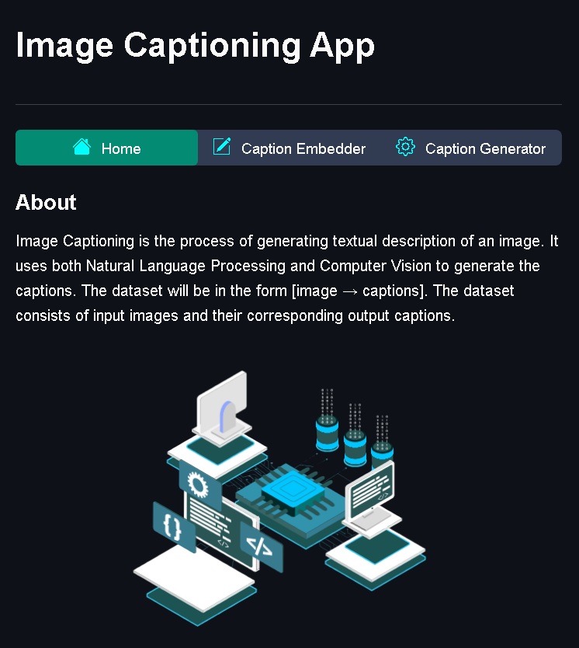
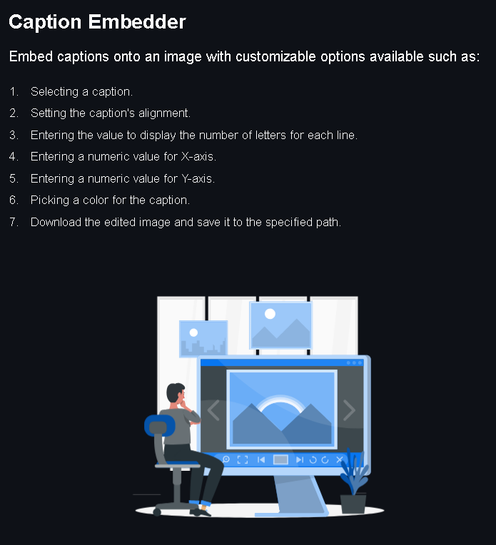
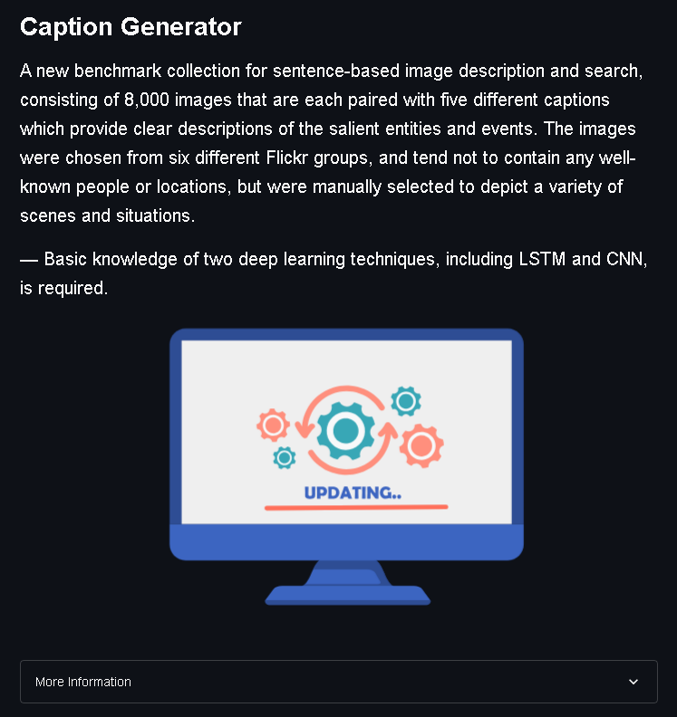
HOME PAGE

Slide 8
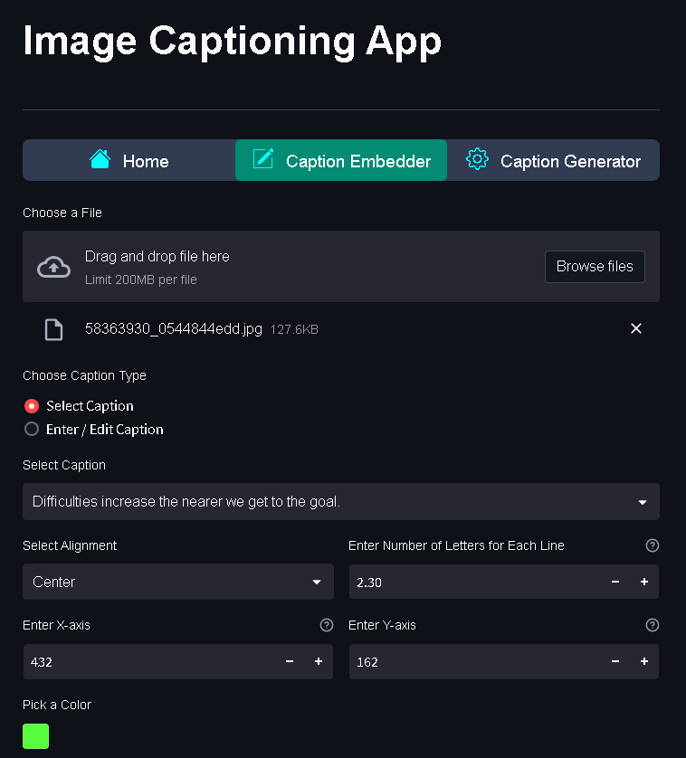
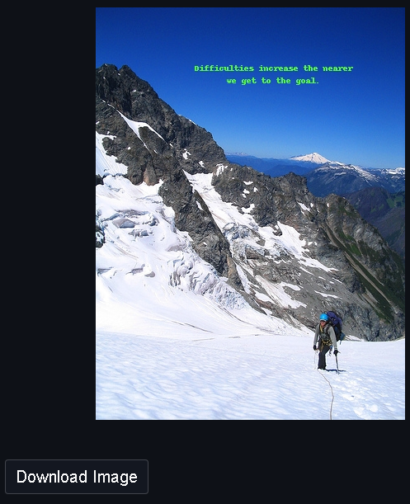
CAPTION EMBEDDER
The user must upload an image and add a caption.
The user has the option to customize the embedded caption.
User can then download the image once satisfied.

Slide 9
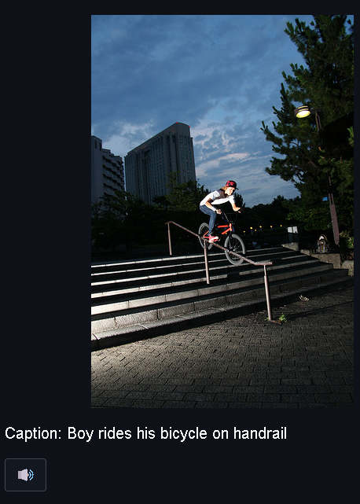
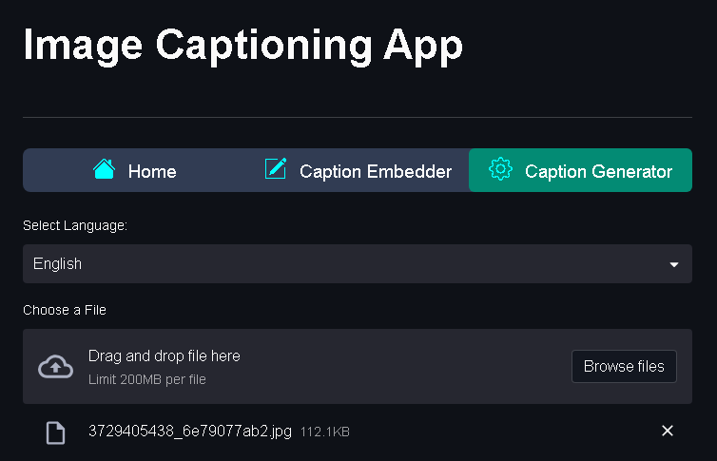
CAPTION GENERATOR
The user must select a language and then upload an image.
It will then generate captions based on the context of the image.
User can also click on the listen button for the text to be read out.

Slide 10
CONTACT PERSON
Please reach out to Kevin Johnson George at
kev11geo@gmail.com for any questions / concerns / suggestions on the App.

Slide 11
THANKS!

